Slide 1
IoE Chapter 6 Configuration Management in IoT- Chef, Puppet Case Studies
Dr. Vinayak A Bharadi
FAMT Ratnagiri

Slide 2
Configuration Management
System Administrators usually perform repetitive tasks such as installing servers, configuring those servers, etc.
They can automate this task, by writing scripts, but it is a very hectic job when you are working on a large infrastructure.
To solve this problem, Configuration Management was introduced. Configuration Management is the practice of handling changes systematically so that a system maintains its integrity over time.

Slide 3
Configuration Management (CM)
ensures that the current design and build state of the system is known, good & trusted; and doesn’t rely on the tacit knowledge of the development team. It allows access to an accurate historical record of system state for project management and audit purposes. Configuration Management overcame the following challenges:
Figuring out which components to change when requirements change.
Redoing an implementation because the requirements have changed since the last implementation.
Reverting to a previous version of the component if you have replaced with a new but flawed version.
Replacing the wrong component because you couldn’t accurately determine which component needed replacing.

Slide 4
Configuration Item (CI)
A Configuration Item (CI) is any service component, infrastructure element, or other item that needs to be managed in order to ensure the successful delivery of services. Examples of CI include individual requirements documents, software, models, and plans.
Configuration Management consists of the following elements:
Configuration Identification
Change Management
Configuration Status Accounting
Configuration Audits

Slide 5
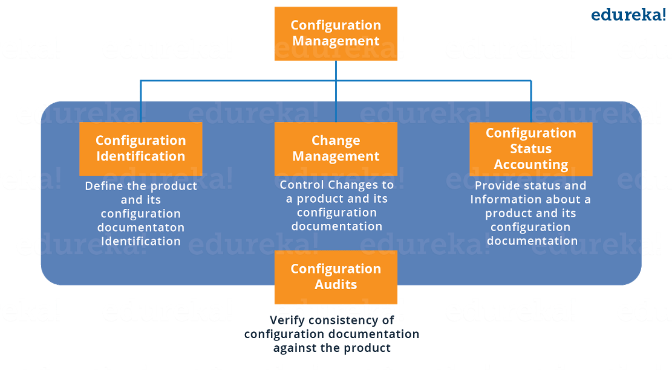

Slide 6
Configuration Identification: It is the process of:
Labeling software and hardware configuration items with unique identifiers
Identifying the documentation that describes a configuration item
Grouping related configuration items into baselines
Labeling revisions to configuration items and baselines.

Slide 7
Change Management:
It is a systematic approach to dealing with change both from the perspective of an organization and the individual.
Configuration Status Accounting: It includes the process of recording and reporting configuration item descriptions (e.g., hardware, software, firmware, etc.) and all departures from the baseline during design and production. In the event of suspected problems, the verification of baseline configuration and approved modifications can be quickly determined.
Configuration Audits: Configuration audits provide a mechanism for determining the degree to which the current state of the system is consistent with the latest baseline and documentation. Basically, it is a formal review to verify that the product being delivered will work as advertised, promoted or in any way promised to the customers. It uses the information available as an outcome of the quality audits and testing along with the configuration status accounting information, to provide assurance that what was required has been build.

Slide 8
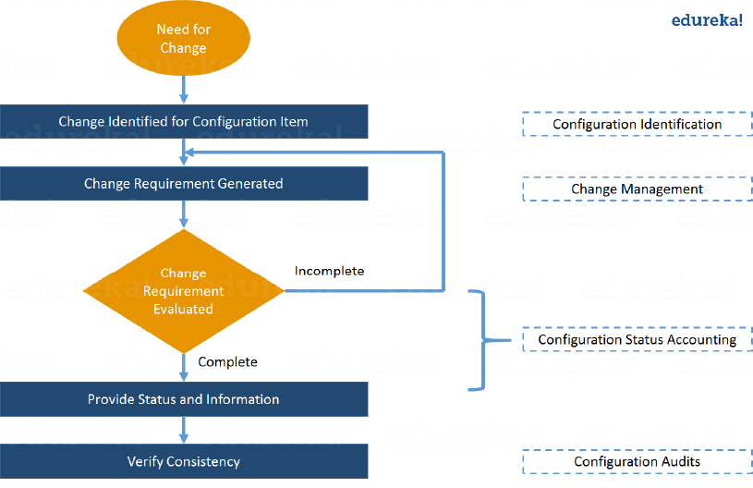
Configuration Management with a use-case
Suppose if you have to update a particular software or you want to replace it, In that case the below flowchart should be followed for successful Configuration Management:

Slide 9
Configuration Management helps in performing the below tasks in a very structured and easy way:
Figuring out which components to change when requirements change.
Redoing an implementation because the requirements have changed since the last implementation.
Reverting to a previous version of the component if you have replaced with a new but flawed version.
Replacing the wrong component because you couldn’t accurately determine which component was supposed to be replaced.

Slide 10
CM Use Case
A software “glitch” prevented the NYSE from trading stocks for almost 90 minutes. This led to millions of dollars of loss. A new software installation caused the problem. That software was installed on 8 of its 20 trading terminals and the system was tested out the night before. However, in the morning, it failed to operate properly on the 8 terminals. So there was a need to switch back to the old software. You might think that this was a failure of NYSE’s Configuration Management process, but in reality it was a success. As a result of a proper Configuration Management process, NYSE recovered from that situation in 90 minutes which was pretty fast. Had the problem continued longer, the consequences would have been more severe.

Slide 11
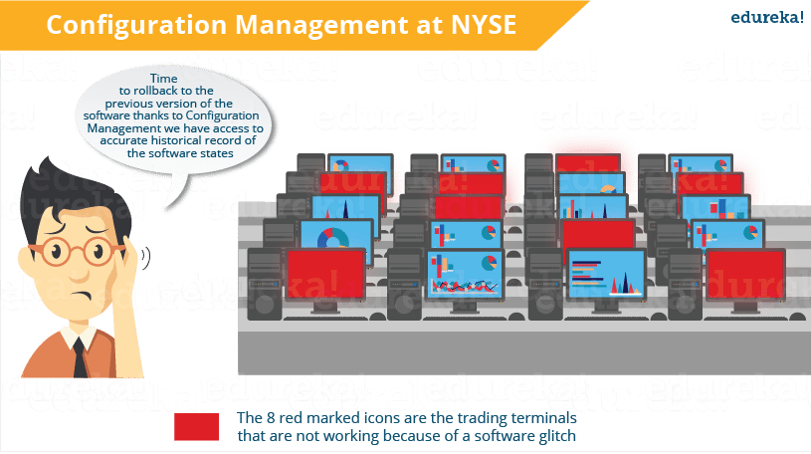

Slide 12
CM
Now, I hope you know the importance of Configuration Management. Configuration Management stage can be considered as the backbone of DevOps.
It allows more frequent software releases in the safest and most reliable way possible.

Slide 13
CM and Puppet
Today, the most mature tool for Configuration Management is Puppet.
What Is Puppet?
Puppet is a Configuration Management tool that is used for deploying, configuring and managing servers. It performs the following functions:
Defining distinct configurations for each and every host, and continuously checking and confirming whether the required configuration is in place and is not altered (if altered Puppet will revert back to the required configuration) on the host.
Dynamic scaling-up and scaling-down of machines.
Providing control over all your configured machines, so a centralized (master-server or repo-based) change gets propagated to all, automatically.
Puppet uses a Master Slave architecture in which the Master and Slave communicate through a secure encrypted channel with the help of SSL.

Slide 14
Puppet Case Study
If you are a poker enthusiast or if you have ever played online games, then you must have heard about Zynga.
It is the world’s largest social game developer. Zynga’s infrastructure uses tens of thousands of servers in both public cloud and private data centers.
Early on they were using a manual process, including kickstarters and post installs to get hundreds of servers online.

Slide 15
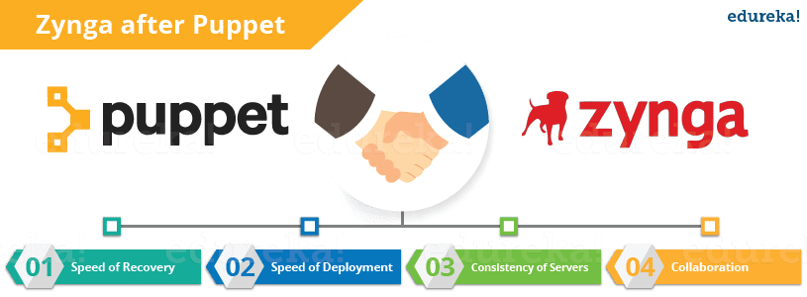
The company was smart enough to quickly realize the need for an automated process even before they hit rapid scaling, that’s when Puppet came into the picture. Let us understand how Puppet contributes to their organization.

Slide 16
Advantages by CM using Puppet
Speed of Recovery – The production operations team can rapidly deploy the right configuration to the right box. If a system gets inappropriately reconfigured Puppet will automatically revert it back to a last stable state, or provide the details necessary to manually remediate a system rapidly.
Speed of Deployment – Puppet has provided significant time savings in the way the operations team delivers services for the gaming studios.
Consistency of Servers – Puppet’s model-driven framework ensures consistent deployments. According to Mark Stockford, Vice President Production Operations, Zynga “It is evident that we have experienced time savings. The beauty of using Puppet is that it allows us to deliver consistent configurations across our servers in a short period every time.”
Collaboration – Having a model-driven approach makes it easy to share configurations across the organization, enabling developers and operations teams to work together to ensure new service delivery is of extremely high quality. Over a dozen people from Zynga’s team got trained in Puppet. This knowledge has been disseminated throughout the team and to the operations teams within each individual gaming studio.

Slide 17
Problem with Manual CM on Zynga
Scalability & Consistency – Zynga was experiencing phenomenal growth and its infrastructure needed to keep pace with the industry. Script-based solutions and manual approaches were not sufficient for their needs.
Portable Infrastructure – Zynga needed a way to leverage a consistent configuration management approach in both their public cloud infrastructure and their own data centers.
Flexibility – Given the diversity of the various Zynga gaming properties, it was important for the team to be able to quickly match the right configuration for the right machine.
Infrastructure Insights – As the organization matured, it became more important to have an automated method of visualizing the properties of each machine.

Slide 18
Chef
Chef is a tool used for Configuration Management and is closely competing with Puppet.
Here we will discuss What is Chef, Configuration Management and how Chef achieves Configuration Management with a use-case.

Slide 19
What Is Chef?
Chef is an automation tool that provides a way to define infrastructure as code.
Infrastructure as code (IAC) simply means that managing infrastructure by writing code (Automating infrastructure) rather than using manual processes.
It can also be termed as programmable infrastructure. Chef uses a pure-Ruby, domain-specific language (DSL) for writing system configurations.

Slide 20
What Is Chef – Chef Key Metrics
Chef supports multiple platforms like AIX, RHEL/CentOS, FreeBSD, OS X, Solaris, Microsoft Windows and Ubuntu. Additional client platforms include Arch Linux, Debian and Fedora.
Chef can be integrated with cloud-based platforms such as Internap, Amazon EC2, Google Cloud Platform, OpenStack, SoftLayer, Microsoft Azure and Rackspace to automatically provision and configure new machines.
Chef has an active, smart and fast growing community support.
Because of Chef’s maturity and flexibility, it is being used by giants like Mozilla, Expedia, Facebook, HP Public Cloud, Prezi, Xero, Ancestry.com, Rackspace, Get Satisfaction, IGN, Marshall University, Socrata, University of Minnesota, Wharton School of the University of Pennsylvania, Bonobos, Splunk, Citi, DueDil, Disney, and Cheezburger.

Slide 21
Below are the types of automation done by Chef, irrespective of the size of infrastructure:
Infrastructure configuration
Application deployment
Configurations are managed across your network
Like Puppet which has a Master-Slave architecture even Chef has a Client-Server architecture. But Chef has an extra component called Workstation. I will talk about workstation in my next blog. Refer the diagram below:

Slide 22
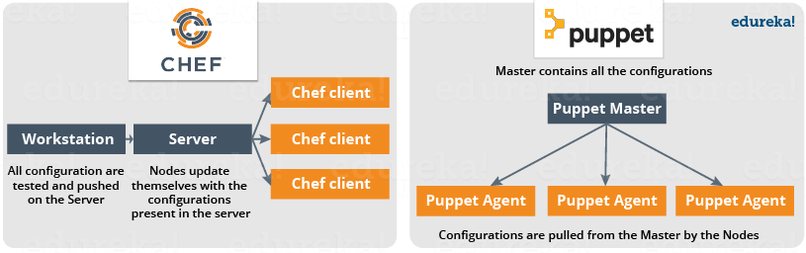
Chef Architecture

Slide 23
In Chef, Nodes are dynamically updated with the configurations in the Server. This is called Pull Configuration which means that we don’t need to execute even a single command on the Chef server to push the configuration on the nodes, nodes will automatically update themselves with the configurations present in the Server
There are broadly two ways to manage your configurations namely Push and Pull configurations.
Pull Configuration: In this type of Configuration Management, the nodes poll a centralized server periodically for updates. These nodes are dynamically configured so basically they are pulling configurations from the centralized server. Pull configuration is used by tools like Chef, Puppet etc.
Push Configuration: In this type of Configuration Management, the centralized Server pushes the configurations to the nodes. Unlike Pull Configuration, there are certain commands that have to be executed in the centralized server in order to configure the nodes. Push Configuration is used by tools like Ansible.

Slide 25
Chef – Use case
Gannett is a publicly traded American media holding company. It is the largest U.S. newspaper publisher as measured by total daily circulation.
It is the largest U.S. newspaper publisher as measured by total daily circulation.
Gannett’s traditional deployment workflow was characterized by multiple handoffs and manual tests.

Slide 26
Problems faced by Gannett with this process
Maintaining accurate, repeatable builds was difficult.
There were many build failures and tests were often running in the wrong environments.
Deployment and provisioning times could range from a few days to several weeks.
Operations team didn’t have access to the cloud or development environments.
Every group used its own tool-set, and there was no accountability to finance or security. No one knew how much an application actually cost. Security had no way to audit the software stacks.

Slide 27
Resolutions
Gannett was ready for the change. Developers wanted to deploy their applications quickly. Operations wanted a stable infrastructure where they could build and deploy in a repeatable way. Finance wanted to know the true cost of an application. Security wanted to view and audit all stacks and to be able to track changes.
Gannett saw that cloud as a service offered many advantages. Developers had access to standardized resources. It was easier to handle peaky traffic because of cloud’s compute-on-demand model, and handoffs were minimized.

Slide 28
Roleplay by Chef
Chef allows you to dynamically provision and de-provision your infrastructure on demand to keep up with peaks in usage and traffic. It enables new services and features to be deployed and updated more frequently, with little risk of downtime. With Chef, you can take advantage of all the flexibility and cost savings that cloud offers.
Let us see what were the functions performed by Chef at Gannett:
Gannett started building VPC (Virtual Private Cloud) for development environment that would mimic the production. None of the tools that they were already using were appropriate. But they found that Chef worked well with the cloud and both Linux and Windows environment. They used Chef to build a development environment that perfectly matched production environment.
For an application to move into the VPC, it had to be provisioned and deployed with Chef.
Security would be involved early on and would manage the mandatory controls for access to Chef and for maintaining system security standards.

Slide 29
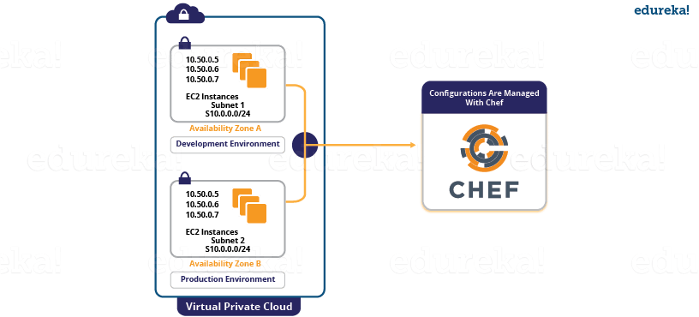
VPC Deployment using Chef

Slide 30
Results
Gannett’s deployment became quicker and more reliable. Application provisioning and deployment, which once took weeks, after using Chef it took minutes.
All new applications were deployed on the cloud with Chef. These applications were deployed to all environments in the same way that they were deployed to production. Also, testing occurred in each environment, so that the deployments were reliable.
All infrastructure was treated as code, which greatly increases visibility into any changes that occurred. Development, Operations, Security and Finance all were benefited from this.

Slide 31
Need for Device Management in IoT
Once an Internet of Things (IoT) device is installed, it is not a “fire and forget” scenario. There will be bug fixes and software updates needed; some devices will fail and need to be repaired or replaced; and each time this happens your company is on the hook to minimize downtime – not only to keep your customers happy, but to ensure that you protect your revenue stream.
Four fundamental device management requirements exist for any Internet of Things (IoT) device deployment:
provisioning and authentication,
configuration and control,
monitoring and diagnostics, and
software updates and maintenance.

Slide 32
Provisioning and authentication
Device authentication is the act of securely establishing the identity of the device to ensure that it can be trusted. A cloud-hosted service that the device connects to needs to know that the device is actually a genuine device, is running trusted software, and is working on the behalf of a trusted user.
Provisioning is the process of enrolling a device into the system. Authentication is part of that process, where only devices that present the proper credentials are registered. The exact details of this process can vary widely based on implementation. However, in most applications, the device being deployed is loaded with a certificate or key (stored in a secure memory area) that identifies it as authentic, and knows the server URL to connect to in order to enroll itself. When the device is first plugged in and connected to the local network, it “calls home,” and then, based on the credentials and other information such as the model and serial number of the device, it might receive further configuration data.

Slide 33
Configuration and control
To implement certain control capability into a system, you’ll want to remotely reset the device so as to achieve a known-good state and recover from errors and implement new configuration changes.
You may also want to be able reset the device to a factory default configuration, which is useful when you want to decommission a device or as a more invasive way to recover from unknown error conditions.
Most of the time, your device will need to be further configured by the end user with attributes such as its name and location and application-specific settings.
Lastly, issuing a command to update or reload firmware is very important in order maintain security of the remote device, implement feature enhancements, and patch bugs.

Slide 34
Monitoring and diagnostics
In a system of thousands of remote devices, the smooth and secure operation of each device can directly affect the financial bottom line. Small issues can impact customer sentiment enough to hamper successful business outcomes. Monitoring and diagnostics are vital to minimize the impact of any device downtime due to software bugs or other unforeseen operational problems.
As an example, you can detect when something is amiss by monitoring compute, storage, networking, and I/O statistics at the task or process level, and comparing those statistics to characterized nominal values.
Being able to download program logs and dumps is also imperative to diagnosing and solving software bugs.
Taking that one step further, device management software might also use cloud-hosted analytics software to provide useful insights into problems that occur across multiple connected devices.

Slide 35
Software maintenance and update
There are a lot of potential levels to software maintenance. On one level, you must have a process to completely and securely update all the device software, including bootloaders and binary blobs.
You might use this to fix a security vulnerability that pervades the platform firmware. To fix application bugs or add simple feature enhancements and save network bandwidth, you may just want to update the main running application software without touching the platform firmware.
Software maintenance in remote devices is a long-term, running process. You may not have a persistent connection to a remote device if, for example, the device communicates via a wireless connection.
The link may not be reliable, especially if the device is moving, or if there is a consumption cost involved in the data connection (for example, via cellular), then the link might be established only periodically to save cost.
Finally, one of the main reasons software updates are complicated is that you need to perform them when there is minimal business impact.

Slide 36
Reference:
http://iotdesign.embedded-computing.com/articles/fundamentals-of-iot-device-management/
https://www.edureka.co/blog/what-is-chef/

